Slide 1
Vulcan Defect Status
Feb. 29, 2016
Tao Wu, Wen Yi Gao

Slide 2
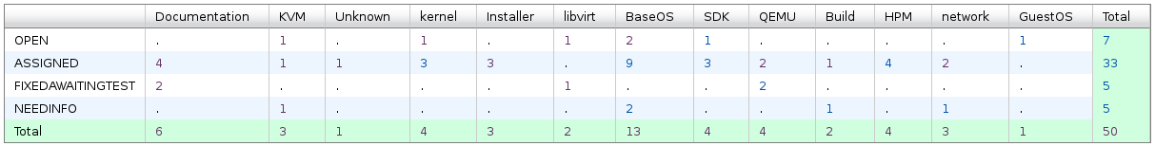
Vulcan - Open Defects
50 open defects including 5 defects in Fix-Awaiting-Test. No blocking defects for Vulcan.
13 defects new opened in the last two weeks, not including 115 HVM bugs. We solved 22 defects in the past two weeks.
Defect statistics:

Slide 3
Vulcan – High Priority Defects
Ship issue:
  Bug 137984 - kernel.pid_max value set is not being used
    Under investigation.
  Bug 137679 - sg_luns cannot display more than 1023 luns
    Under investigation.
  Bug 137694 - License files for FP1
    Michael Ranweiler will provide latest 7/3/2016 the input license file.
    Ken can process within one day the LICR files and provide the LICR-ID.

Slide 4
Vulcan – All Defects
396 normal and other 115 HVM defects opened in the Vulcan Bugzilla until now.

